Slide 1


DATA SCIENCE 2 - DATA & A.I. 3
V MACHINE LEARNING
4-7 ML TECHNIQUES
11/10/2024

Slide 2
I
II III
PYTHON BASICS
Python for data science
WORKING WITH
ARRAYS
Numpy
DATA SCIENCE 2 DATA & A.I. 3
IV
V
DATA VISUALISATION
Matplotlib
DATA ENGINEERING
pandas
MACHINE LEARNING
Automatically find patterns

Slide 3

MACHINE LEARNING
scimit-le»ín

Slide 4
01
WHAT IS MACHINE
LEARNING
Automatically find patterns
05
0G
07
08
DECISION TREES
Best separating lines
INTRODUCING
SCIKIT-LEARN
Machine learning with Python
02
03
04
K-MEANS CLUSTERING
Object grouping
MACHINE LEARNING
HYPERPARAMETERS AND CROSS VALIDATION
Holdout samples and cross-validation
ASSOCIATION RULES
Frequent itemsets
REGRESSION
Best fitting line
ARTIFICIAL NEURAL
NETWORK
Imitate the human brain

Slide 5

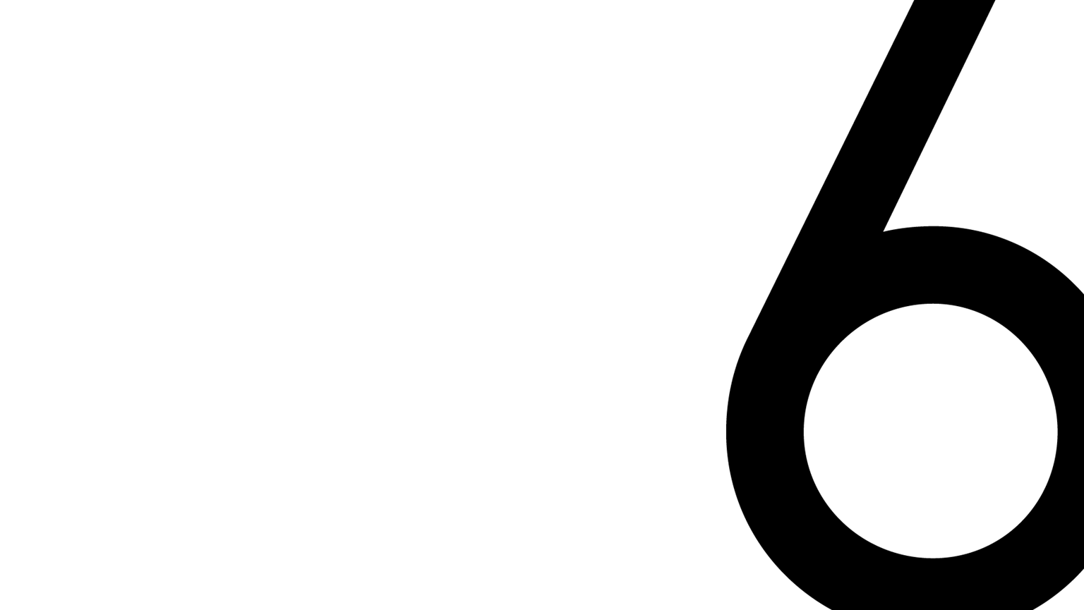
UNSUPERVISED LEARNING: CLUSTERING
K-Me»ns

Slide 6
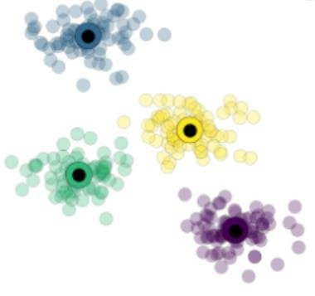
K-MEANS CLUSTERING
K-Means Clustering:
An unsupervised machine learning algorithm used to group similar data points into a predefined number of clusters based on
their feature similarities.
See Data & A.I. 2
Notes:
Als je 2 features hebt kun je k-means clustering doen om de data punten te bekijken
Gaat voor alle samples bepalen bij welk punt ze het dichtste liggen

Slide 7
K-MEANS CLUSTERING WITH SCIKIT-LEARN
from sklearn.cluster import KMeans model = KMeans(n_clusters=4)
Hyperparameters:
n_clusters
Type: int, default=8
Description: The number of clusters to form, and the number of centroids to generate.
Usage: Set this to specify how many groups you want the data divided into.
init
Type: {‘k-means++’, ‘random’}, default=‘k-means++’
Description: Method for initializing the cluster centroids. k-means++ chooses centroids to speed up convergence, while random selects random points.
Usage: k-means++ is typically preferred, but random can be used for experimentation.
max_iter
Type: int, default=300
Description: The maximum number of iterations allowed for the algorithm to run until it converges.
Usage: Increase this if your model is not converging, but usually the default works well.
Notes:
Importeren deze en we kiezen hoeveel clusters we willen, default is 8 maar gaan deze eigenlijk altijd een waarde geven
We starten altijd met n-clusters willekeurige punten, maar de initiele punten kunnen we ook wat kiezen, random is echt random k-means++ gaan we inteligenter kiezen zodanig dat we minder iteraties nodig hebben om een goede uitkomst te krijgen
By default itereert hij 300 keer maar kunnen we ook aanpassen, zal tot hier gaan of tot

Slide 8
K-MEANS CLUSTERING WITH SCIKIT-LEARN
Hyperparameters:
tol
Type: float, default=1e-4
Description: The tolerance for the convergence criterion. The algorithm stops when the difference in the cluster centers falls below this
threshold.
Usage: Decrease this value to make the algorithm more precise at the cost of computation time.
n_init
Type: int, default=10
Description: The number of times the algorithm will be run with different centroid seeds. The final result will be the best output of these runs.
Usage: Increase this to get a more stable result by running the algorithm multiple times with different initializations.
algorithm
Type: {‘auto’, ‘full’, ‘elkan’}, default=‘llkan’
Description: The algorithm to use for clustering. elkan is faster with sparse data, while full uses the standard EM-style algorithm.
Usage: elkan is recommended for efficiency, especially when handling large datasets.
random_state
Type: int, default=None
Description: The seed used by the random number generator. Setting this ensures the same results each time the algorithm is run.
Usage: Useful when you want reproducible results.
Notes:
Tolerantie is wanneer hij zou stoppen, is hier 10 tot de -4e dat ze zouden veranderen.
Zal die 300 iteraties n_init keer doen, default zal hij deze 10 keer doen. Om daar dan de beste uit te kiezen
De beste is wanneer de gemiddelde afstand van een cluster tot een punt het kleinste is
Als je ziet dat er een gigantisch verschil in grootte is tussen data zullen we deze eerst moeten scalen.

Slide 9
K-MEANS CLUSTERING WITH SCIKIT-LEARN
# Import necessary libraries
import numpy as np import pandas as pd
from sklearn.cluster import KMeans
import seaborn as sns
import matplotlib.pyplot as plt
# Create or load some example data
# For illustration, we generate a synthetic dataset from sklearn.datasets import make_blobs
# Generate synthetic data with 4 clusters
X, y_true = make_blobs(n_samples=300, centers=4, cluster_std=0.60, random_state=42)
# Initialize and fit the KMeans model
kmeans = KMeans(n_clusters=4, init='k-means++', max_iter=300, random_state=42) kmeans.fit(X)
# Get the cluster centers and labels centroids = kmeans.cluster_centers_ labels = kmeans.labels_
Notes:
Hier is het unsupervised learning dus geven bij de fit maar 1 parameter mee. Heeft hier ook geen zin om op te splitsen in training en test dus geven deze gewoon heel de dataset mee
Dan bekijken we de centroids en zetten we de labels

Slide 10
K-MEANS CLUSTERING WITH SCIKIT-LEARN
# Get the cluster centers and labels centroids = kmeans.cluster_centers_ labels = kmeans.labels_
# Visualize the clusters
plt.figure(figsize=(8, 6))
# Plot the points and color by cluster
sns.scatterplot(x=X[:, 0], y=X[:, 1], hue=labels, palette="viridis", s=100, alpha=0.6, edgecolor="k")
# Plot the centroids
plt.scatter(centroids[:, 0], centroids[:, 1], s=300, c='red', label='Centroids') plt.title('KMeans Clustering')
plt.legend() plt.show()
# Predicting new points
new_points = np.array([[0, 0], [5, 5], [-5, -5]]) predictions = kmeans.predict(new_points) print(f"Cluster labels for new points: {predictions}")

Slide 11
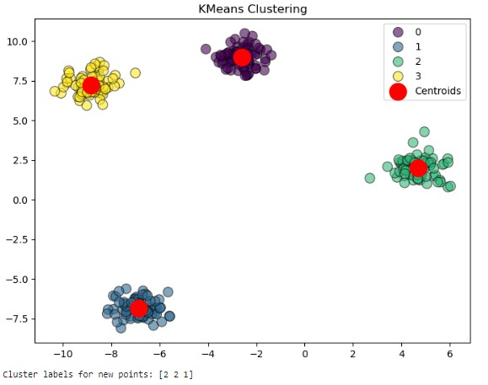
K-MEANS CLUSTERING WITH SCIKIT-LEARN EXAMPLE

